Slide 1
Cross-Platform Mobile APP development
Esdras Lopez

Slide 2
Overview
Choosing a Platform
Understanding the Challenge
Cross-Platform Options
Demo
Conclusions

Slide 3
Facts to consider
Smartphones Popularity
New technologies
new programming languages and operating systems
Expected lineup of events?
Lifelong learning
(IEEE and ACM code of ethics)
Using existing knowledge
Reduce the learning curve
Save time
Boost productivity
[Clifford 2014]

Slide 4
Choosing a platform
Reach vs Revenue

Slide 5
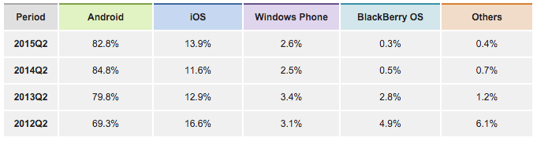
Reach - Market Share
[www.idc.com 2015]
Notes:
From Figures 3 and 4 numbers we can conclude that if we were to develop only for iOS and Android we would be already covering 96.7% of the market, which is a fantastic reach. But even if we would only do Android, with 82.8%, we would still be well positioned in the market.

Slide 6
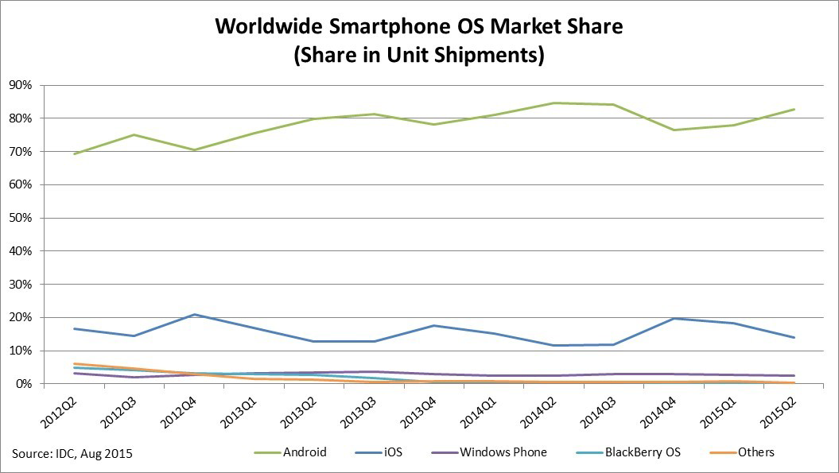

Slide 7
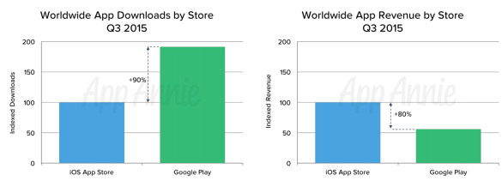
Revenue
[Perez 2015]

Slide 8
Understanding the Challenge
What you need to know about the platforms

Slide 9
Android
Java – Android SDK
C/C++ - Native Development Kit (NDK)
Games or physics simulations.
Reuse C or C++ libraries.
Android Studio, Android Official IDE
Windows, Mac OS X, and Linux.
Notes:
Squeeze extra performance out of a device for computationally intensive applications like games or physics simulations.
Reuse your own or other developers' C or C++ libraries.

Slide 10
iOS
Objective-C
Swift
Xcode, official IDE
Only available in Mac OS X
Swift Open Source possibilities
Notes:
Squeeze extra performance out of a device for computationally intensive applications like games or physics simulations.
Reuse your own or other developers' C or C++ libraries.

Slide 11
Windows Phone OS
Windows Phone 8 vs Windows 10 Mobile
Windows Phone 8
(C#, Visual Basic, or C++) with XAML
Windows 10
(C++ or C#) with XAML
JavaScript with HTML
Visual Studio, official IDE.
Windows 8 64 bit is required for Windows Phone 8
Windows 10 for Windows 10 apps
Windows can be easily ran in Linux and Mac OS X using VM like Virtual Box
Notes:
Squeeze extra performance out of a device for computationally intensive applications like games or physics simulations.
Reuse your own or other developers' C or C++ libraries.

Slide 12
BlackBerry OS
C/C++/Qt
JavaScript/CCS/HTML
ActionScript/AIR
Java Android
IDEs available in Windows, Mac OS X, and Linux
Notes:
Squeeze extra performance out of a device for computationally intensive applications like games or physics simulations.
Reuse your own or other developers' C or C++ libraries.

Slide 13
Cross-Platform Options
There could be a better way to do things…

Slide 14
WEB vs hybrid vs native

Slide 15
XAmarin
Build native apps using C# for the logic and using native-like tools for their layout
iOS, Android and Windows Phones
Visual Studio can be used but depends on a Mac Host to be in the same LAN to design the layout and build the iOS app
Creates hybrids with native UI
Cost per developer
Indie $25/month
Business $999/year (Student License)
Enterprise $1899/year

Slide 16
Xamarin cont.

Slide 17
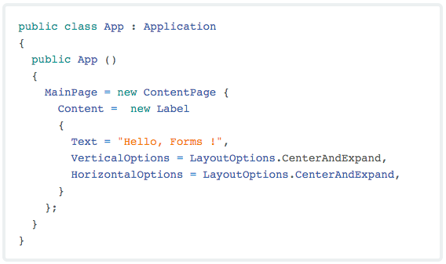
Xamarin cont.

Slide 18
Xamarin cont.

Slide 19
Xamarin cont.

Slide 20
Xamarin Pros
Can reuse about two thirds of a single C# code base
High performance of UI due to the use of native APIs
OS-specific UI design
Cloud based quality assurance services such as functionality testing for bugs in thousands of devices to ensure optimal performance

Slide 21
Xamarin CONS
Apps' startup times can be slow due to the overhead of the linking of codes and referencing between the .Net framework and the targeted OS
UI development is not portable, but platform specific
UI design can become very time-consuming as the complexity of the app increases
Limited support for coding outside of Xamarin (This is less of a problem as popularity of Xamarin increases and the developer community grows)
Xamarin code cannot be reused for native HTML5, iOS, or Android-native development
iOS platform-specific development (like UI) cannot be done without access to a MAC in the local network

Slide 22
PhoneGap
Use HTML, CSS, and JavaScript for logic and layout design
Android, iOS and Windows Phones supported
Creates hybrid and web apps
Cost: Free

Slide 23
PhoneGap cont.

Slide 24
PhoneGap Pros
Web developers can use their HTML, CSS, and JavaScript skills right away because the adoption of the platform requires little to no training
Modular plugin architecture. Device's features can be accessed as needed in a modular fashion.
No license cost - the platform is free and open source
Builds are done in the cloud thanks to Adobe PhoneGap Build, which eliminates the need of a local SDK and allows non-Mac users to build iOS applications

Slide 25
PhoneGap CONS
There is a large library of plugins available, but because of the fact that PhoneGap is open-source, the functionality you might be looking for might not be updated or available for the desired platform
The idea of having to create your own plugins outweighs the benefit of going multiplatform, because you will have to create the plugin, probably writing lots of platform specific code
Performance is often not optimal when compared to native apps, but the gap is narrowing as hardware in devices improves

Slide 26
Appcelerator
Use JavaScript and Titanium IDE for app development
Native-like performance for iOS and Android
Creates hybrids with native UI
Cost
Indie $39/month (Try)
Team $259/month
Enterprise – Contact Sales

Slide 27
Appcelerator cont.

Slide 28
Appcelerator Pros
Great performance thanks to the use of native UI components
All coding is done in JavaScript and easily reused in any platform that can interpret it
Appcelerator platform includes real-time analytics, push notifications, and cloud services to connect mobile apps to any data source

Slide 29
Appcelerator CONS
Development is platform dependent – iOS app can only be built using Appcelerator in a Mac
While using UI-native components is a great performance boost, the training process of the Titanium APIs can be very time consuming, and the skills gained are not transferable outside of Titanium

Slide 30
SENCHA
Uses JavaScript and Sencha Touch IDE
HTML5 based
Provides customizable and ready-to-use UI components such as themes, widgets, layouts and animations.
Cost: $4,000 – $7,000 with 5 licenses minimum.
Standard
Pro
Premium

Slide 31
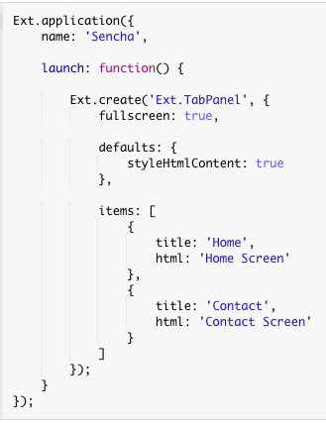

Sencha cont.

Slide 32
Sencha Pros
Sencha Touch can be integrated with Sencha Architect, which allows the creation of apps in an easy drag-and-drop environment
Development can be done in MVC
Extensive library of UI components, APIs and themes
Apache Cordova/Cordova integration allows native packaging of apps

Slide 33
Sencha CONS
Apps can suffer the same performance problems that PhoneGap apps do
Working on Sencha framework can be perceived as limiting, due to many other framework options available with HTML5/CSS/JavaScript support
Writing custom Apache Cordova/PhoneGap plugins to extend Sencha Touch functionality requires training in platform-specific skills

Slide 34
Xamarin Weather app
Visual Studio version available at:
https://github.com/elopez1/xamarin-weather-app

Slide 35
Conclusions
Smartphones could become the only computer in less than two years
The future of apps is on the rise and as Computer Scientists we need to prepare for it. Polish our skills and have options.
Should you go cross-platform with these tools?
You don’t need to launch on both platforms.
Cross-platform frameworks are not magic.
One, many, or none

Slide 36
Questions?

Slide 37
References

Slide 38
Aamoth, D., 2014. First Smartphone Turns 20: Fun Facts About Simon. TIME.com. Bloch, O., 2012. How to develop for Windows Phone 8 on your Mac - Interoperability @ Microsoft - Site Home - MSDN Blogs. Blogs.msdn.com. Brown, M., 2002. Talk by Steven Jobs - IDCA 1983, Aspen: soundcloud.com. Chu, E., 2008. Android Market: Now available for users | Android Developers Blog. Android- developers.blogspot.com. Clifford, C., 2014. By 2017, the App Market Will Be a $77 Billion Industry (Infographic).Entrepreneur. Computer History Museum, 2012. Simon Personal Communicator Phone (1993). Cordova.apache.org, Apache Cordova. Cowart, J., 2013. Pros and Cons of the Top 5 Cross-Platform Tools - Developer Economics. Developer Economics. Dev.windows.com, Get started with Windows apps - Windows app development. Developer.android.com, Android Developers. Developer.apple.com, 2014. About Objective-C. Developer.apple.com, Swift - Apple Developer. Developer.blackberry.com, Platform Choice - BlackBerry Developer. Developer.xamarin.com, An Introduction to Xamarin.Forms - Xamarin. Developer.xamarin.com, Part 1 – Understanding the Xamarin Mobile Platform - Xamarin. Docs.appcelerator.com, Appcelerator Platform - Appcelerator Docs. Frommer, D., 2016. 10 Ways The iPhone Changed Smartphones Forever. Business Insider. Hachman, M., 2015. Steve Ballmer thinks the future of Windows Phone is Android—and he may be right. PCWorld. Hutchinson, A., 2005. The Top 50 Inventions of the Past 50 Years. Popular Mechanics. Khan, D., 2016. BlackBerry may abandon BB10 operating system and and switch to Android - The Economic Times. The Economic Times. Lee, J., 2015. Apple’s Swift Is Going Open Source: So What?. MakeUseOf. Merriam-webster.com, 2016. Definition of SMARTPHONE. Msdn.microsoft.com, Getting started with developing for Windows Phone 8. Perez, S., 2015. iOS App Store Revenue Now 80 Percent Higher Than Google Play, Thanks To China.TechCrunch. Phonegap.com, PhoneGap | Supported Features. Sencha.com, Cross-platform Mobile Web App Development Framework for HTML5 and JS | Sencha. Sherlock, P., 2015. Xamarin 介紹. Slideshare.net. Swift.org, 2015. Swift.org. Technologies, A., 2015. A History of Mobile Apps. 1983 - 2014 & Beyond. Thomas, T., 2015. Technical Perspectives: The Pros and Cons of Using Xamarin for Cross-Platform Mobile App Development. www.linkedin.com. TIME.com, 2016. All-TIME 100 Gadgets - TIME. Trice, A., 2012. PhoneGap | PhoneGap Explained Visually. Phonegap.com. Wu, A., 2016. TrendForce Says Huawei Led the Global Rise of Chinese Smartphone Brands in 2015 by Shipping Over 100 Million Units to Take No. 3 Worldwide. Press.trendforce.com. www.idc.com, 2015. IDC: Smartphone OS Market Share. Xamarin.com, Mobile Application Development to Build Apps in C# - Xamarin.

